Slide 1
Module 8
Rogue Trading, BIM Consulting, and Nerds Galore

Slide 2
Chapter 23
Control Failure: Rogue Trading at Société Générale

Slide 3
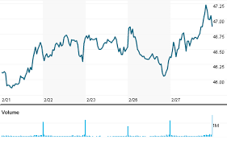
Notes:
Vast growth lead to sloppy controls and utter ERM failure – pg 462-464
1999-2006 Société Générale net income increased 164% from £2 billion to £5.2 billion
Main driver of growth was corporate and investment banking division (CIB)
Main driver in CIB was fixed income, foreign exchange (FX), and equity and commodity trading by 77%
Daniel Bouton, DEO since 1999 lead this charge to large growth and expansion
Main problem was the rogue trader incident by Jerome Kerviel which lead to a massive overall £7 billion failure
Additionally Bouton (CEO) had unprecedented permission from France’s Financial Markets Authority to secretly unwind Kerviel’s directional equity index positions over 3 days before making market announcement of rogue trader
The pattern of internal controls and ERM systems – pg 468
June 2006 – pricing discrepancies
Dec 2006-June 2007 – 5 queries – earnings discrepancies
Jan to Oct 2007 – 9 queries – unidentified counterparty or broker
Jan to Nov 2007 – 7 queries – unexplained balance sheet variations
Jan 2007 to Jan 2008 – 3 queries – trade entry errors
Feb 2007 – 1 query – trade settlement discrepancy
March to Oct 2007 – 12 queries – P&L and provision discrepancies, high notional amount of transactions
June to Aug 2007 – 2 queries – reconciliation differences
Dec 2007 – 1 query – High broker commissions

Slide 4
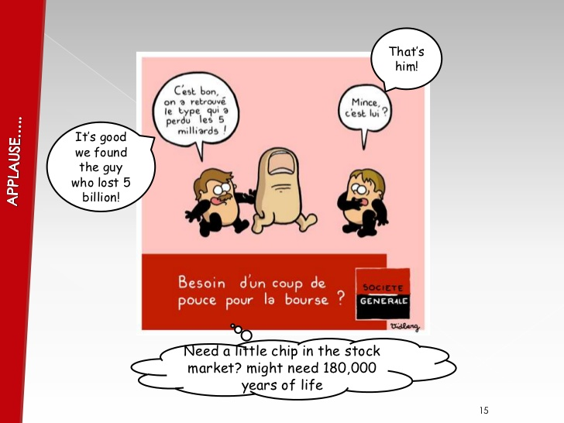
Notes:
Main failures within Société Générale – pg 472-474
Managerial supervision
Trading management did not have explicit requirements to monitor cash movements
Monitoring was only performing sporadic reviews of financial reporting of traders
Poor manager training to ensure proper codes and systems were understood
Poor follow up of unauthorized positions
Control Environment
No limits on notional transaction volumes
Trade cancellations, modifications, deferred start dates, and provisions were not subject to exception treatment
Inadequate separation of duties
Escalation of concerns were unclear or nonexistent
No minimum consecutive days of vacation required
Back office poor communication
No validation of cause or solution to problems for exposure issues
System Reliability
Faulty security protocols
Chronic accuracy, reliability, and timeliness problems thus causing expectations of errors
Risk Sensitive Culture
Trading oversight and control personnel were not trained or instructed to be alert for fraud or slow to responding in resolving queries

Slide 5
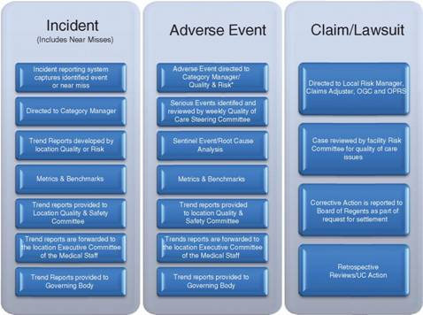
UC’s Enterprise Risk Management Approach to the Evaluation of Incidents, Events, and Claims
https://www.bing.com/images/search?view=detailV2&ccid=qHFjJ2xj&id=2248F368E223FE86B738D48E84CF24D1B3E977D2&thid=OIP.qHFjJ2xj7y34I7-aB_FmpAEsDf&mediaurl=http%3a%2f%2facademlib.com%2fimag%2fmanag%2ffras_imperm%2fimage015.jpg&exph=356&expw=478&q=uc+enterprise+risk+management&simid=608016123784267626&selectedIndex=12&ajaxhist=0

Slide 6

Société Générale Control Failure
https://www.bing.com/videos/search?q=Societe+Generale+ERM+failure&&view=detail&mid=D139C09351E12EFD1DADD139C09351E12EFD1DAD&FORM=VRDGAR

Slide 7

Downside Risk Failures
https://www.youtube.com/watch?v=TklHyjkQefk

Slide 8
Chapter 26
BIM Consultants, Inc.

Slide 9

Notes:
Company overview – pg 525
Medium consulting firm in 10 offices across Canada – 3,000 staff
Revenue stagnant and driving internal need to expand or loose significant talent
Case Opportunity – ERM perspective – pg 525-526
Purchase 12 offices across Canada – 3,500 additional staff
Possible doubling of sales
Move into number one position of consulting in Canada
Opportunities to move into midtier client work

Slide 10
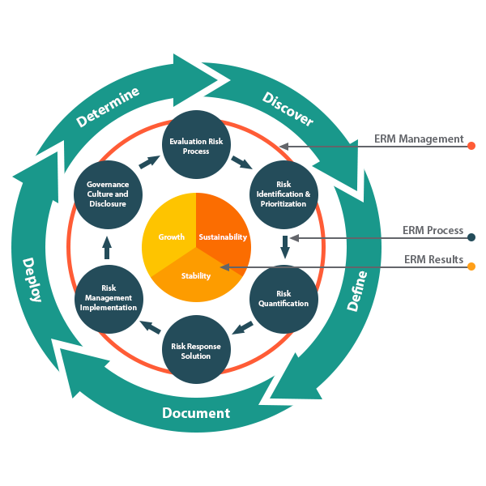
Risk ERM System Chart
https://www.bing.com/images/search?view=detailV2&ccid=WbKq7W0j&id=B6431AB5806AF277174CAD3042CA8D2336E86BCE&thid=OIP.WbKq7W0jP3eDk_upNJ_8bgD6D6&mediaurl=http%3a%2f%2feccinternational.com%2fimages%2fcontent%2fERM.jpg&exph=600&expw=600&q=ERM+Risk+Items&simid=608043383924327253&selectedIndex=7&ajaxhist=0

Slide 11
Chapter 27
Nerds Galore

Slide 12

Notes:
Company overview – page 529
Canadian service company – 1,000 employees in 12 Canadian cities
Full service IT support services to small and medium sized Canadian businesses
Formed in 2000 from Jeeves Stobes
Focus on small start-up businesses
Mainly low technology experience customers
Excellent reputation
Shifting strategy of customer/sales
Moving to mid-sized organizations to gain additional revenue and increase billing rates
Requires more sophisticated technology needs
Current Risks/Problems
Loss of reputational risk
Loss of staff
High training costs
Upselling pressures to installers
Internal school
Failure on handling employee death response to employees
Positive notes
Revenue has not declined and actually increased
May be due to timing of contractual payments

Slide 13
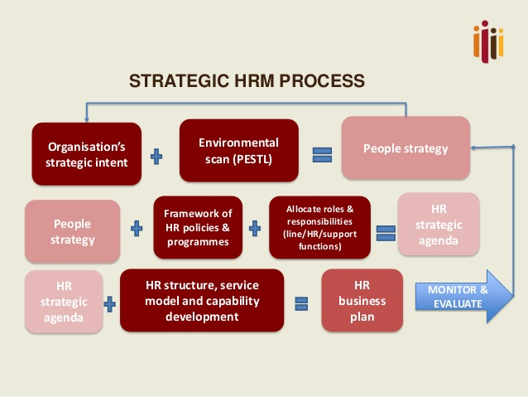
Notes:
HR strategy to resolve possible risks
Attract best talent - positive and flexible work environments
Retain good people – employee recognition programs, cross training, compensation at 75th percentile of competitors
Manage talent – formal talent management program to identify high potential employees
Optimize the use of people – Better scheduling with new internal software
Enable outsourcing to handle overflow of work and not overstress existing employees

Slide 14
References
John R.S. Fraser, B. J. (2015). Implementing Enterprise Risk Management.
New Jersey: Wiley & Son, Inc.,

